Slide 1

Italian restaurant in Bogotá
Juan Sebastián Riveros

Slide 2
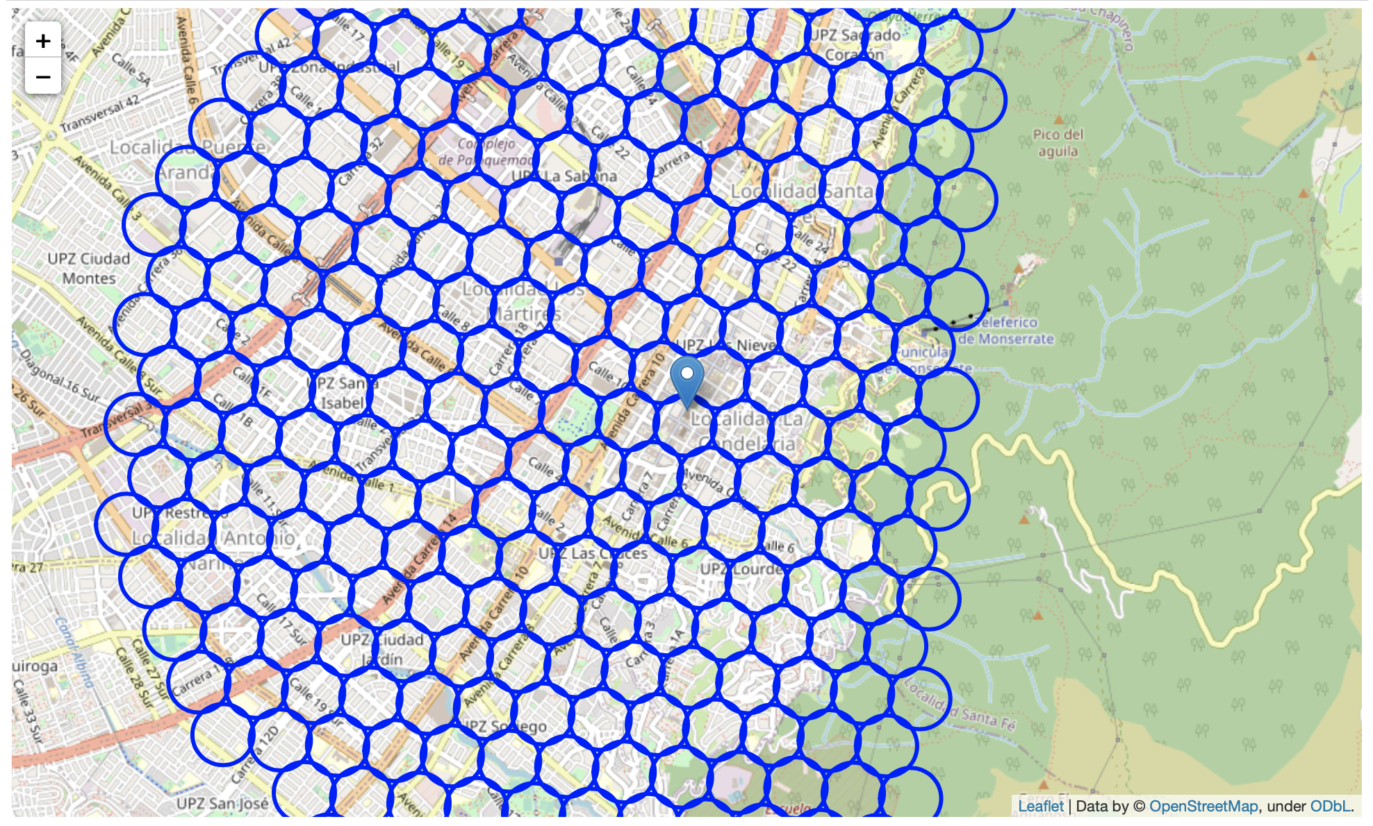
Area divisions

Slide 3
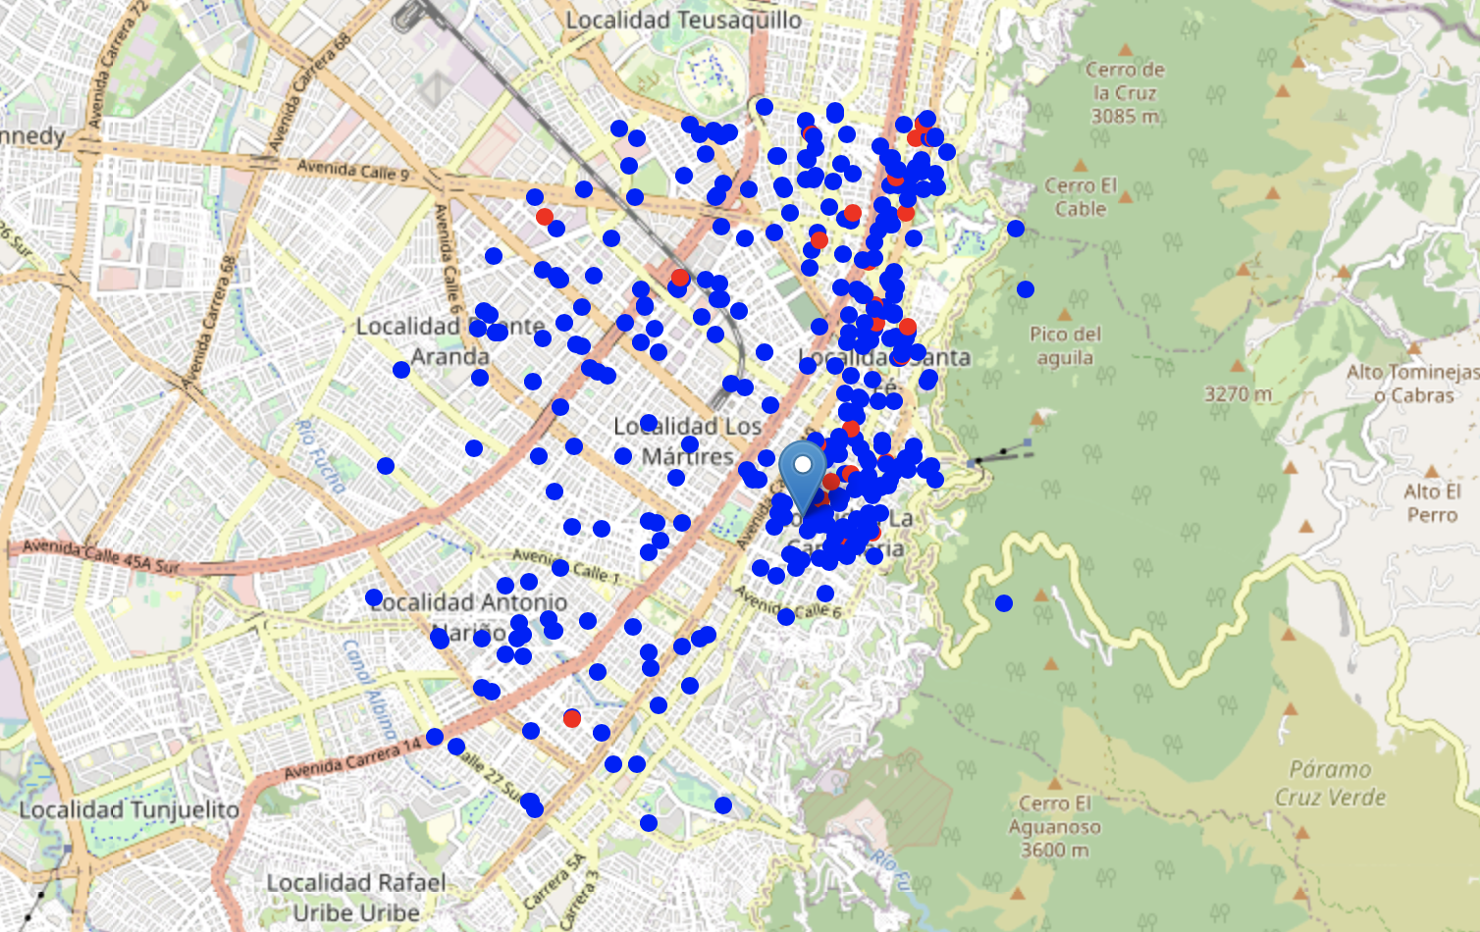
Italian and other restaurant locations

Slide 4
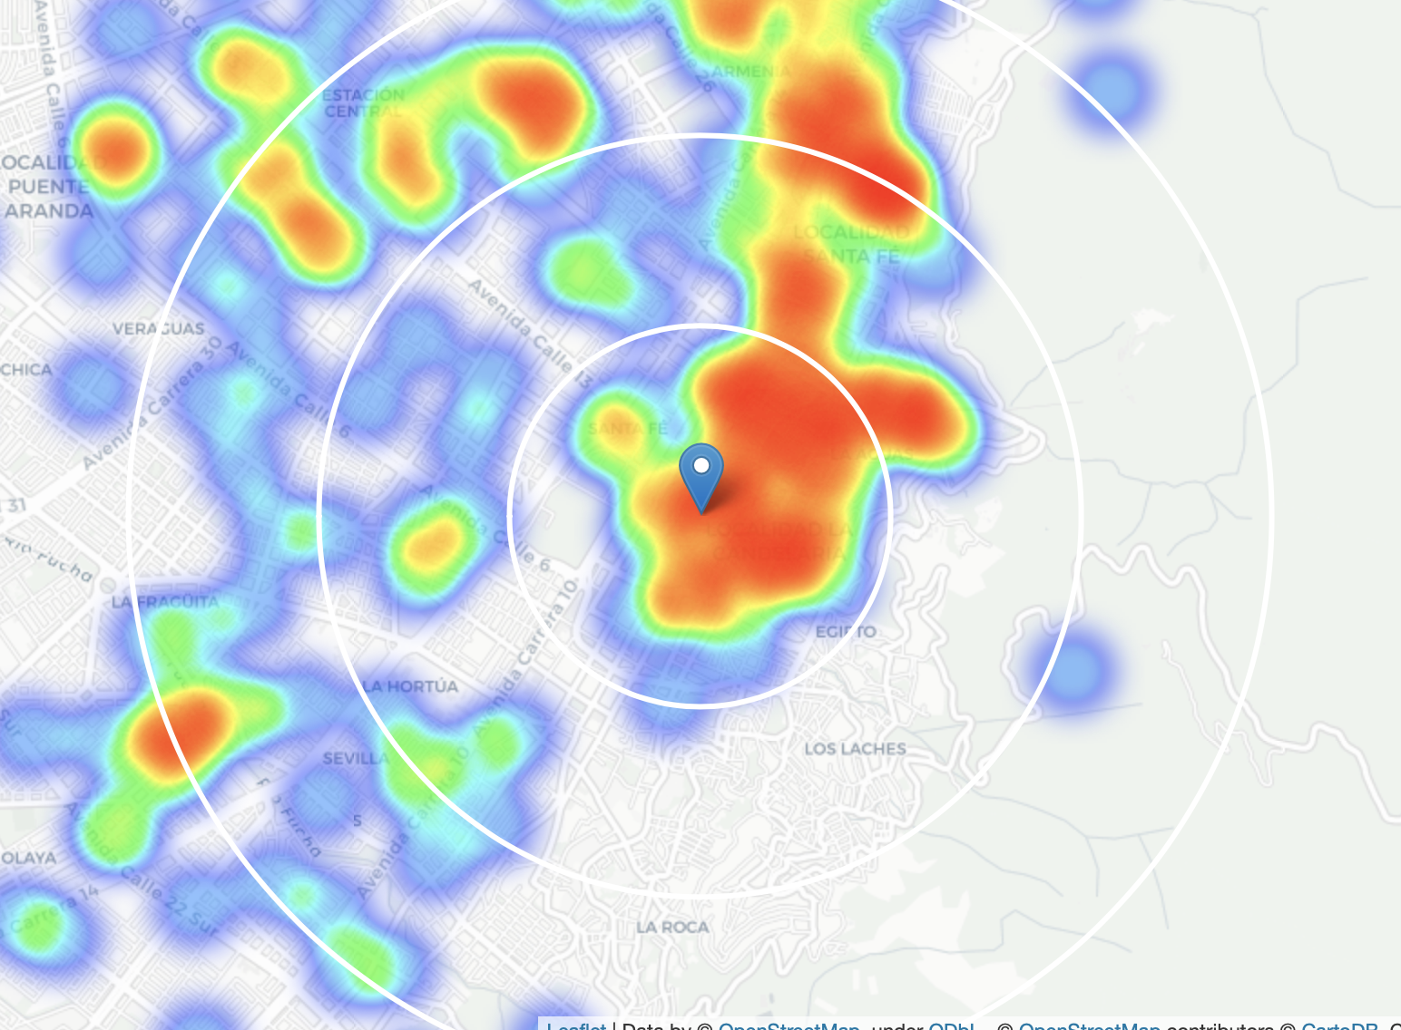
Restaurant density in Bogotá

Slide 5
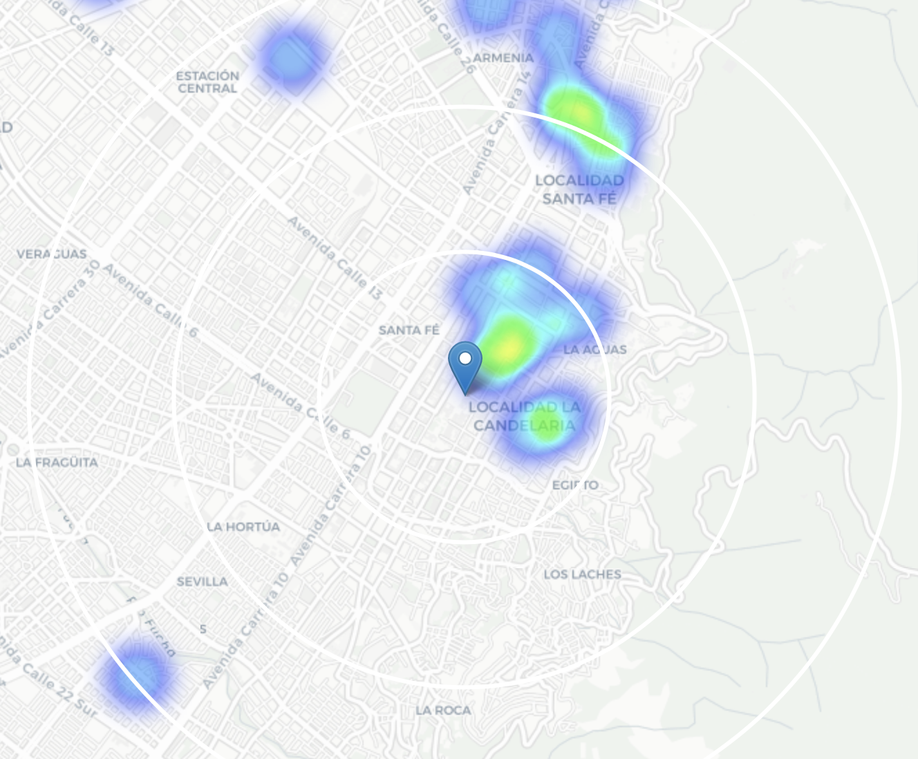
Italian restaurant density in Bogotá

Slide 6
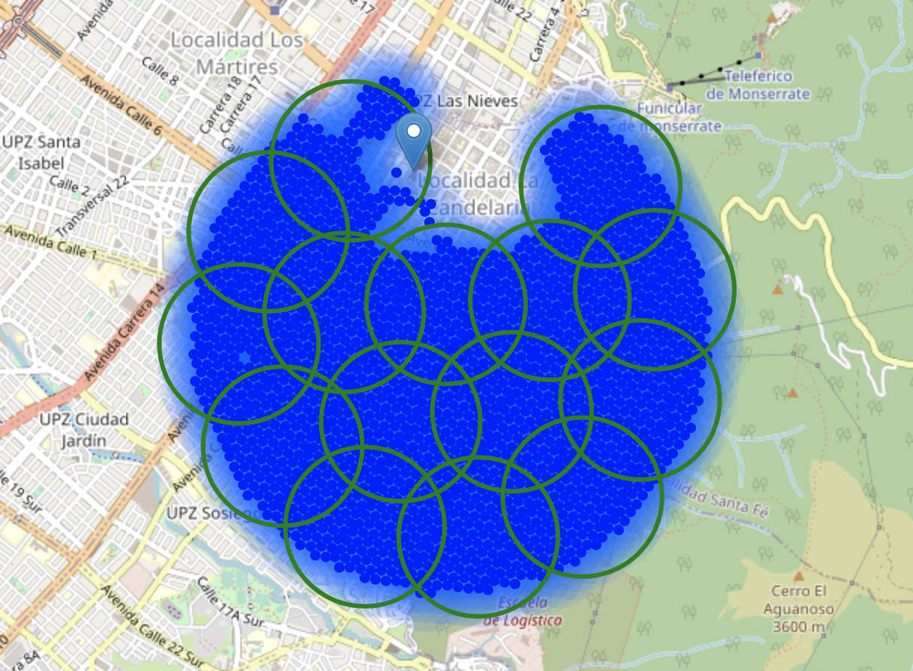
Potential cluster locations

Slide 7
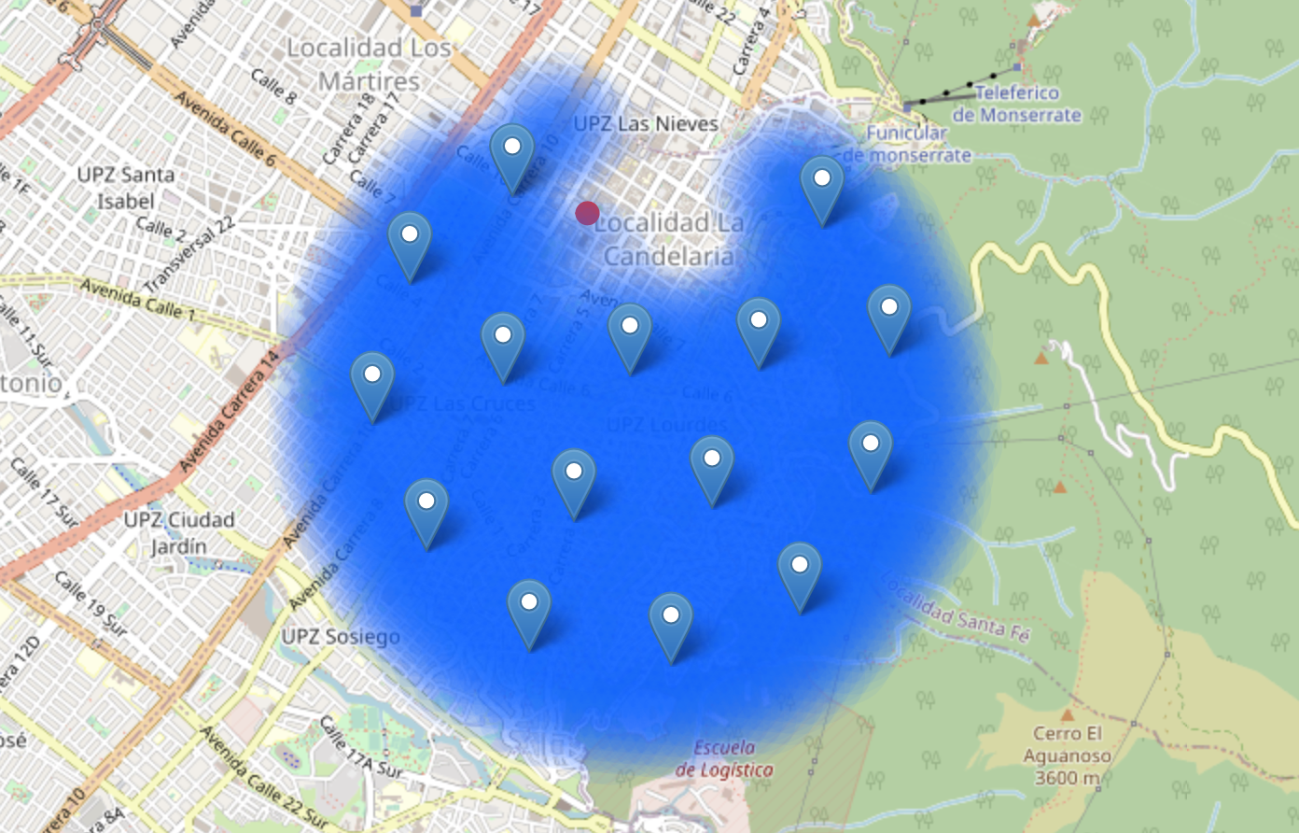
Potential locations

Slide 8
Thank you

